Slide 1
PR PROCESS: DEVISING PR CAMPAIGN
Chapter 4

Slide 2
7 Cs of PR Communication
Credibility: Receiver must have confidence & high regard in the sender, this is built by earnest effort & performance on the part of the org & PR
Context: A communication program must be in touch with the realities of its environment. Mass media only supplement the words & deeds of actual situation. The PR msg is not only communicated in the context but should be consistent with the present context
Effective communication requires supportive context that is largely set by media

Slide 3
7 Cs of PR Communication
Content: The msg must have meaning to the receiver & be compatible with their value systems
Clarity: The msg must be simple
Continuity & consistency: Comm is an unending process. It requires repetition to ensure diffusion

Slide 4
7 Cs of PR Communication
Channels: Established channels of comm should be used, the ones receivers use & respect since people associate diff values to diff channels
Capability of the audience: Communications are most effective when they require least effort on the part of the receivers

Slide 5
Types of PR Campaigns
Product Campaign
Image/Reputation Building Campaign
Issues Management Campaign
Information/CSR Campaign
Internal Communication Campaign
Crisis Management Campaign

Slide 6
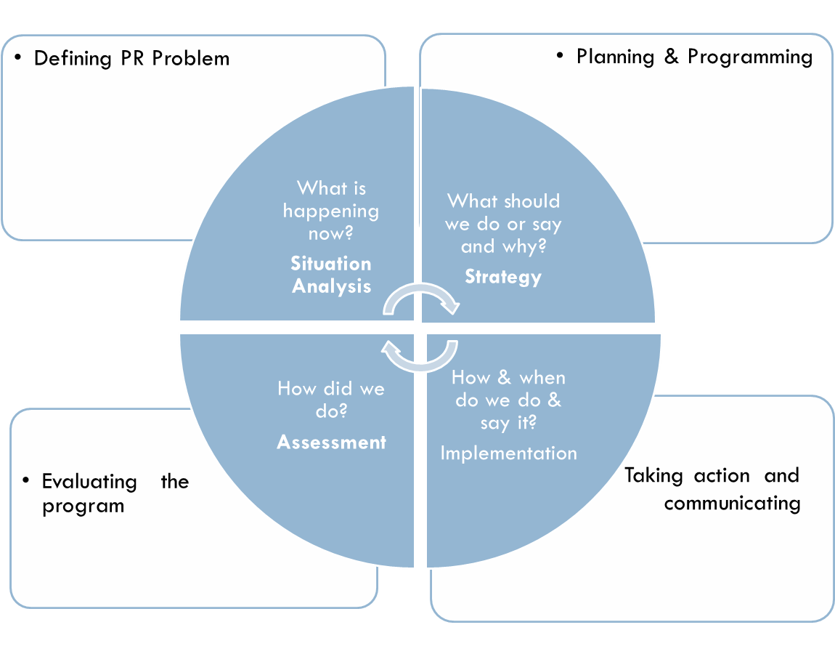
Four Step PR Process

Slide 7
Defining The Problem
Step 1

Slide 8
Defining PR Problems
A PR problem is not necessarily a crisis situation
Problem definition begins with the judgment that something is wrong, could be wrong or something could be made better
Once the judgment is made, the process becomes a systematic research task designed to answer the question, “What is happening now?”

Slide 9
Why research is necessary in PR process?
To plan the strategy it is necessary to understand the situation in which your client is operating & the key stakeholders
Research should answer specific questions:
Who is the campaign aimed at & what are their characteristics?
Which are the best channels of comm. to reach them?
What is the opinion of TA about the company?
Who are the influencers in the specific situation?
Notes:
Refer Intro to PR by Keith Butterick-Pg 131

Slide 10
Research Methods
Informal
Personal Contacts
Key Informants
Focus Groups and Community Forums
Mail Analysis
Online sources: blogs & social media discussions
Formal
Secondary Analysis & Online Database
Surveys through mailed Questionnaires & In-person Interviews
Content Analysis

Slide 11
Research Methods
Specific methods for gathering, analyzing and interpreting data
Informal or Exploratory Methods
Pretesting for Research-Good for detecting and exploring problem
Disadvantage-The samples used are of unknown representatives of publics-might not be applicable to all

Slide 12
Informal or Exploratory Methods
Personal Contacts
Key Informants
Focus Groups and Community Forums
Mail Analysis
Online sources: blogs & social media discussions

Slide 13
Formal Methods
Gather data from scientifically representative samples & statistical data hence more accurate statement about the publics can be made
Secondary Analysis & Online Database
Major newspapers, television stations & research centers regularly conduct & report surveys
Surveys through mailed Questionnaires & In-person Interviews

Slide 14
Formal Methods
3) Content Analysis
It is the application of systematic procedures for objectively determining what is being reported in media-Press clippings & broadcast monitor reports
Drawback: It indicates what is being printed/broadcast & not what the audience reaction is-insights into future public agenda

Slide 15
Communication Audit
Documentation of org’s communication to understand how & what the company communicates with its publics
It takes into consideration Internal and External factors

Slide 16
Internal Factors
Statements of organization’s mission, history & structure
Lists & info of key officers, board members etc.
Descriptions of programs, products & services
Statistics about resources, budget, sales, profit, etc.
Policy statements related to the problem situation
Statements by key people regarding problem situation
How organization handles the problem situation
Details of internal stakeholders-Stakeholder Analysis
List of organizational media (two way) to communicate with internal publics

Slide 17
External Factors
Clippings from newspapers, magazines, trade publication coverage of the org & problem situation
Reports on TV & online
Content analysis of media coverage
Lists of media, journalists, talk show hosts who report about the org & issues related to the problem situation
Lists of government agencies and officials with regulatory powers affecting org & problem situation
Information on individuals & groups who share org’s concern & positions on problem situation
Information on individuals & groups who oppose org’s positions on problem situation
Results of surveys & public opinion polls
Schedules of special events related to organization & problem situation

Slide 18
Problem Statement
It is written in present tense, describing the current situation
It describes the situation in measurable terms & answers the following questions:
-What is the source of concern?
-Where is this a problem?
-When is it a problem?
-Who is involved or affected?
-How are they involved or affected?
-Why is this a concern to the organization & its publics

Slide 19
Problem Statement
  It does not imply solution or place blame-it is based on research & does not give any particular strategy
  Only 20% of employees understand the company’s performance based increment system whereas 80% of employees are still unclear, resulting in increased frustration & angst
  75% of the target audience (consumers) are unaware of the health benefits of Olive oil like lowering levels of cholesterol; resulting in rejection on the basis of high price

